Slide 1
VCMS Project & Proposal Design
Vladimir Alexiev, PhD, PMP* Data and Ontology Group, Ontotext
(*what is this TLA? May have bearing later on…)
COST Action IS1005, Medioevo Europeo VCMS Meeting, Budapest, Hungary, 17-Oct-13

Slide 2
Presentation Outline
About Ontotext
Clients
Projects in Cultural Heritage
A large-scale project
European projects
Sample Projects in eInfrastructures and Digital Humanities
VCMS Proposal, Project, System Considerations
EU Horizon 2020 Funding Instruments
FET Open
ICT 2014-2015
eInfrastructures
Humanities??

Slide 3
About Ontotext
Innovative BG SME, leader in Semantic Technology software
Semantic database (repository): OWLIM
Text analytics, semantic annotation, entity extraction, search: KIM
Web mining: job offers, cars, recipes, etc.
Data integration, conversion, metadata and ontology management, Linked Data
Verticals and markets
Publishing (dynamic semantic publishing), both Media and Publishers
Life Sciences and pharmaceuticals
Cultural Heritage and Digital Humanities
Company information
Part of Sirma Group, largest private Bulgarian software holding
Established in 2000 as a research laboratory, working on NLP and semantics
Received venture funding and spun off as separate company in 2008
80 employees and contractors
Offices in Bulgaria (Sofia, Varna). Representation in London and New York

Slide 4



















Ontotext Clients

Slide 5
Projects in Cultural Heritage
The National Archives (UK ): Semantic Knowledge Base
The British Museum (UK): ResearchSpace project, funding by Mellon Foundation
Yale Center for British Art (USA): Linked Open Data publishing of museum collection
National Gallery of Art (US): ConservationSpace project, funding by Mellon Foundation
Bulgariana: aggregator to contribute key Bulgarian content to Europeana
Europeana EDM SPARQL endpoint: http://europeana.ontotext.com
Europeana Creative: re-use of cultural heritage metadata and content by the creative industries
Ambrosia (Europeana Food and Drink): explore and celebrate European cultural identity through its culinary and social history.
Dutch Public Library (Netherlands): cultural heritage aggregation
Projects using Ontotext technology: 3D COFORM, V-MUST, IdeaGarden, CHARISMA, LODAC, Polish Digital National Museum…
Active in CIDOC CRM (organized CRMEX workshop on practical experience with CRM)

Slide 6
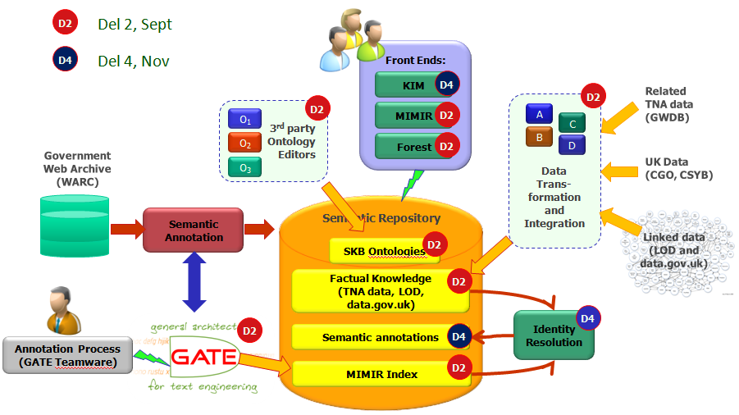
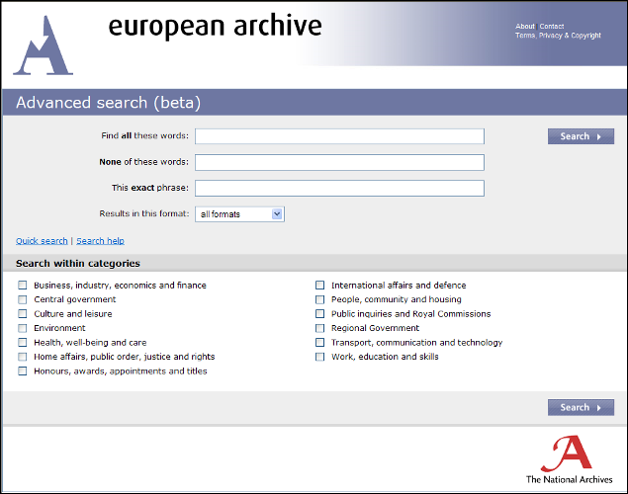
UK National Archives: Semantic KB
Example of large-scale semantic processing
Semantic index for the entire UK Government Web Archive
700M documents: 42TB, 1.3B files
160M unique documents after de-duplication
Background knowledge (UK Government Ontology): 5B facts
Automatic text analysis: extracted 3B facts of metadata
Faceted semantic search in KIM
33K hours of cloud processing; up to 500 servers
www.ontotext.com/case/nationalArchives-skb

Slide 7
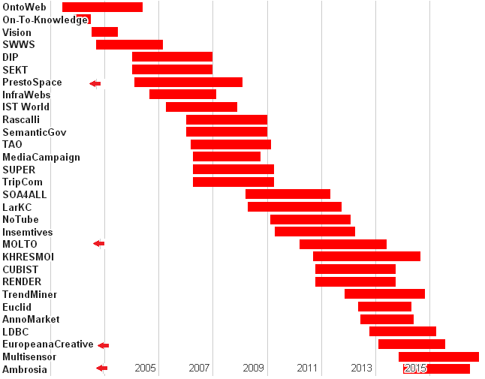
EC Research Projects (FP5-FP7)
Bulgaria's biggest participant. 20.8% of projects (15 of 72), 36.6% of funding
Arrows: CH projects. About ~10 more projects are also relevant to CH

Slide 8
Sample Projects
Research Infrastructures, Digital Humanities…

Slide 9
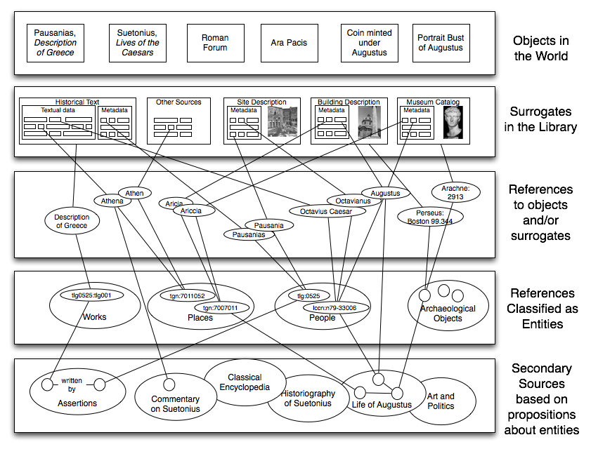
Model of Digital Scholarship
Robert Kummer, "Named Entity Identification / Disambiguation", Uni Koeln, Sep 2007

Slide 10
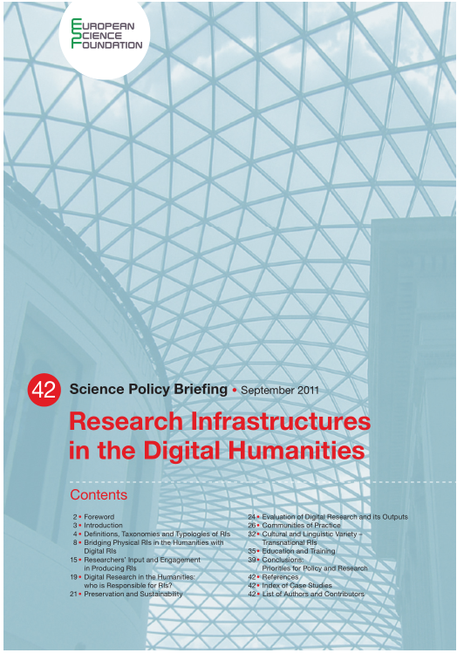
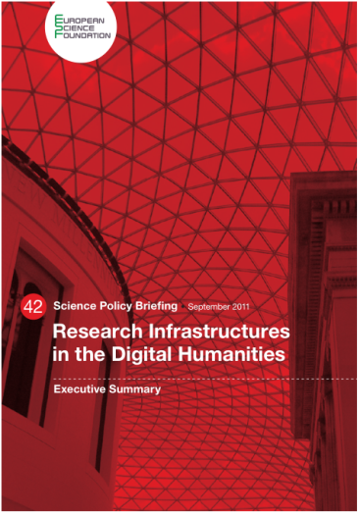
Research Infrastructures in the Humanities
RI are about data centers, peta-bytes, mega-FLOPS, millions of cores…
Are RI relevant to Humanities? RI in the Digital Humanities: ESF Science Policy Briefing 2011
4 Definitions, Taxonomies and Typologies of RIs
8 Bridging Physical RIs in the Humanities with Digital RIs
15 Researchers’ Input and Engagement in Producing RIs
19 Digital Research in the Humanities: who is Responsible for RIs?
21 Preservation and Sustainability
24 Evaluation of Digital Research and its Outputs
26 Communities of Practice
32 Cultural and Linguistic Variety – Transnational RIs
35 Education and Training
39 Conclusions: Priorities for Policy and Research
42 References
CLARIN (ERIC), DARIAH (getting there)

Slide 11
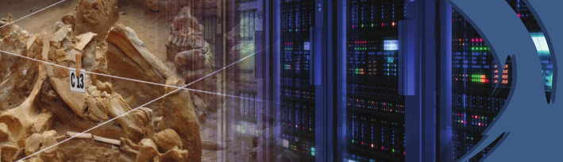
Sample RI project: ARIADNE
Advanced Research Infrastructure for Archaeological Dataset Networking in Europe
Associated to (but not funded by!) DARIAH
Funding: FP7 eInfrastructures IA
EU financial contribution: 6.5 MEUR
Period: 48 months (Feb 2013 - Jan 2017)
24 partners from 13 countries. Include most existing national services, e.g.: ADS UK, SNDS, DANS NL, DAI DE, Fasti Online

Slide 12
Sample Project: ChartEx
Funded by the Digging Into Data scheme
4 countries, 10 funding agencies
New ways of exploring full text content of digital historical records: medieval charters. One of the richest sources for studying the lives of people in the past (prosopography)
Enable users to dig into the data of these records, to recover their rich descriptions of places and people
Go beyond current digital catalogues which restrict searches to a few key facts about each document (the ‘metadata’)
Uses machine learning NLP techniques: learns from a manually curated Gold Standard corpus
Same approach was we use with commercial Concept Extraction services for Media and Publishers: BBC, UK Press Association, NDP Dutch Press Association, etc
Uses BRAT, a text annotation tool that allows to express entities, concepts, relations, sentence structure, metaphor, etc
We also intend to use BRAT in our projects

Slide 13
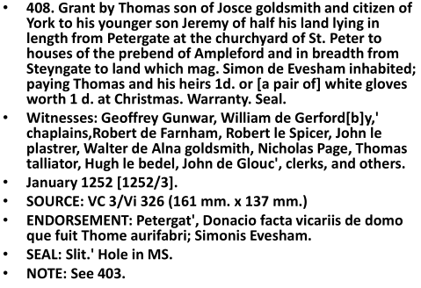
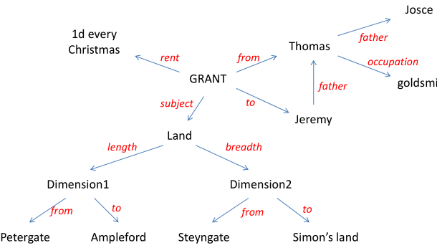
ChartEx Purpose
From charters to data (networks of related entities)
how?
What for? Extract history from documents
Sarah Rees Jones, Christopher Power; ChartEx: Discovering spatial descriptions and relationships in medieval charters. University of York, Nov 2012

Slide 14
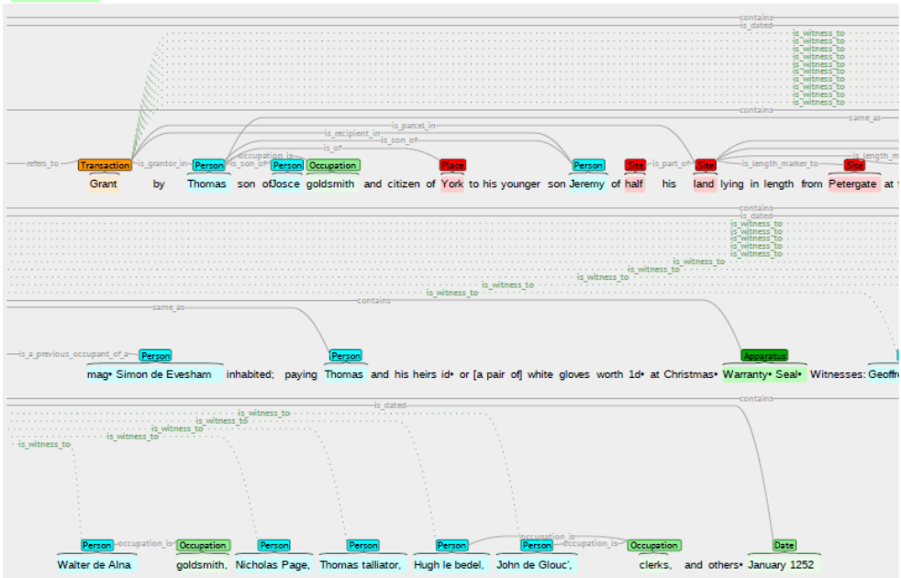
Use of BRAT in ChartEx

Slide 15
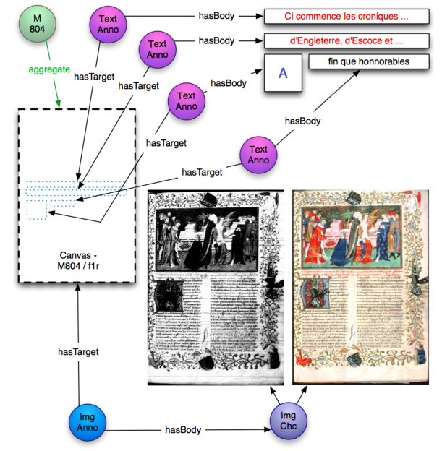
Sample Project: SharedCanvas
SharedCanvas: A Collaborative Model for Medieval Manuscript Layout Dissemination
Robert Sanderson, Herbert Van de Sompel (LANL), Benjamin Albritton (Stanford U), Rafael Schwemmer (U Fribourg)
OpenAnnotation & AnnotationOntology: unified ontology for annotation, bookmarking, placement of texts, images, videos…

Slide 16
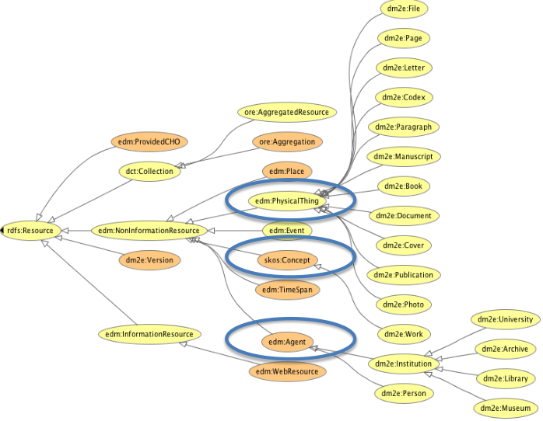
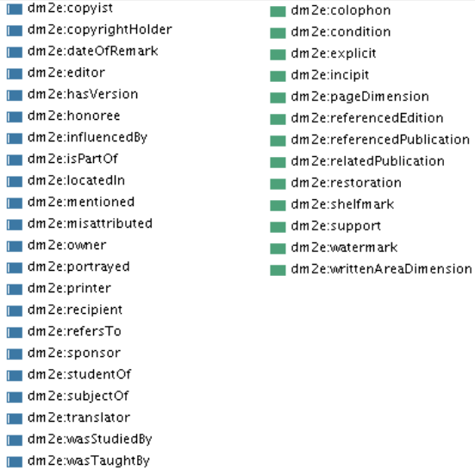
Sample Ontology: DM2E EDM+
"Digital Manuscripts to Europeana" project
Ontology for manuscripts (extension of EDM), conversion of sources
Use OWLIM as semantic repository
EDM for DM2E. Julia Iwanowa, Evelyn Dröge, Steffen Hennicke. Nov 2012

Slide 17
VCMS Project Design

Slide 18
I see VCMS as a Program
Set of interrelated projects having a common goal
Why
You have a very strong foundation: databases & community
Integrating the existing databases in a deep way will open new (revolutionary?) avenues of research
The full scope is a very ambitious undertaking
Start small, expand, build for the future
Design several proposals according to funding schemes
Explore the funding schemes hinted in this presentation. And others!!
Select appropriate schemes
Design proposals in compliance with the schemes
Coordinate the sequence of projects
Don't invest emotionally in a proposal: success rate us 15-25%, and there is an element of chance (do invest your effort and good thinking)
If rejected but the proposal is good, try again (resubmit to another scheme)

Slide 19
VCMS Proposal Inputs

Slide 20
VCMS Considerations
Search aggregators (or meta-search: Trame, MegaRep, TraLiRo) are a first IMPORTANT step towards integration
In the early days of the web, search aggregators were quite popular (e.g. MetaCrawler) because there weren't very good search engines
Now Google (and to a smaller extent Bing and Yahoo) do all you need most of the time, so nobody uses search aggregators
Google uses quite a lot of semtech under the hood: Knowledge Graph, schema.org, microdata & microformats, NLP ("do as you mean")
Shortcomings of search aggregation:
Replicates the shortcomings of the original databases
Only Union queries, can't do Joins (cross-refer information between two databases)
Often a least-common-denominator of individual query languages
Can't provide good ranking, which is very important for researchers
What more can be done by semantic indexing of the databases
Powerful full-text index through NLP techniques using the TEI dictionaries
Semantic extraction of Entities, Concepts, Relations
Information Extraction: document clustering, categorization, classification
Unify schemata & terminology across databases (to some extent)
But who will provide the full text of their database?
If you have enough to start with, and do interesting things with them
Then others will join! A network/avalanche effect

Slide 21
Possible VCMS Architecture
This is incomplete… (and may never be really COMPLETE)
E.g. imaging tools are missing
E.g. dictionaries are a source for "Medieval dbPedia"

Slide 22
VCMS Conclusions
You have a lot of data and accumulated knowledge
Work has been ongoing for 100s of years (>20 years with computers)
But the IT engagement has been ad-hoc, with small funding, with "do-it-yourself" approaches
It's an interesting domain: IT specialists will find it fascinating to work on it! Be more daring: Ask and ye shall receive
Many industrial-strength approaches (from Publishing, Life Sciences, etc) can be applied to your domain
Other CH domains (archaeology, numismatics, linguistics, editions) are already adopting semantic approaches
Also Consider the Open Data and Open Science initiatives that EU is driving for. Soon, scientific contribution won't be measured by publications alone

Slide 23
VCMS Next Steps
At this meeting
Determine potential VCMS scope (for a first project)
Appoint people responsible for the proposal
(maybe) Determine Work Packages and WP leads
After this meeting
Research and select appropriate funding topics
Determine overall consortium
Create proposal structure
Schedule a proposal writing meeting
etc

Slide 24
EU H2020 Funding Instruments

Slide 25
EU Horizon 2020
H2020 (aka FP8) is EU's science program 2014-2020
I'm convinced this is the best way to realize the VCMS envisioned by the COST action, since some participant countries have little access to national funds
I think the following programs are relevant for us:
FET Open (Future and Emerging Technologies)
ICT ("Information and Communication Technologies", part of topic 5 Leadership in enabling and industrial technologies)
eInfrastructures (shared between DG RTD and DG CONNECT) and Open Data / Open Science / eScience
Marie Curie actions (researcher exchanges, Initial Training Networks, etc)
JRC Frontier research by the best individual teams (?? not sure)
Social Science and Humanities (?? only heard about them)
The info below is from:
Presentation "FET in H2020", Roumen Borissov, DG CONNECT (13 Jun 2013)
Presentation of Morten Møller, DG CONNECT (5 Sep 2013)
Draft of ICT WP 2014–2015 (9 Sep 2013)
ICT WP to be announced officially at ICT 2013 conference (6-8 Nov 2013, Vilnius)
But I don't have enough info about the other programs yet, esp. Humanities

Slide 26

H2020: ICT in Excellent Science
Schematic on different strands of work. But there are more ICT topics
E-Infra-
structures
Digital
Science
High-Performance Computing (HPC) Strategy
Future and Emerging Technologies
Individual research projects
Open research clusters
Common research agendas
FET Open
FET Proactive
FET Flagships
Early Ideas
Incubation
Large-Scale Initiatives

Slide 27
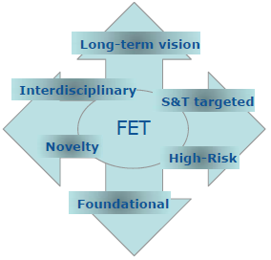
FET Open
Pros
Exploring promising visionary ideas that can contribute to challenges of long term importance for Europe.
'Roots-up' approaches
Challenging Current Thinking
International Cooperation
Stimulates non-conventional targeted exploratory research cutting across all disciplines
Exploring and nurturing new research trends, helping them mature in emerging research communities.
Short proposals (5-10p), easy to write.
Double-blind evaluation, fast decision
Cons
Small projects
Low success rate
Not an easy path for fast-track innovation

Slide 28
H2020-ICT-2014
Open Dec 2013, Close 23 Apr 2014, Result Sep 2014
Potentially applicable topics (code, MEUR):
ICT2: 48M Smart System Integration
ICT7 :73M Advanced Cloud Infrastructures and Services
ICT15: 50M Big data Innovation and take-up
ICT17: 15M Cracking the language barrier
ICT18: 15M Support the growth of ICT innovative Creative Industries SMEs
ICT22: 31M Multimodal and Natural computer interaction
ICT30: 7M Human-centric Digital Age
Need to research and decide which are applicable!

Slide 29
H2020-ICT-2015
Open Jul 2014, Close 20 Jan 2015, Result Jun 2015
ICT8 : 22M Boosting public sector productivity and innovation through cloud computing services
ICT16: 39M Big data - research
ICT19 :41M Technologies for creative industries, social media and convergence.
ICT20: 52M Technologies for better human learning and teaching

Slide 30
Research Infrastructures WP 2014-2015
CALL 1
Developing new
world class infrastructures
Support to the implementation of cross-cutting infrastructure services and solutions for cluster of ESFRI and other rilevant Reserach Infrastructure initiatives in a given thematic area
Design Studies
+
Support to
Preparatory Phase
of ESFRI projects
+
Support to the individual
implementation and operation
of ESFRI projects
+
CALL 2
Opening up infrastructures
Integrating and opening existing national and regional research infrastructures of
pan-European interest
CALL 3
e-Infrastructures
Managing, preserving and computing
with big reserach data
+
e-Infrastructures for Open Access
+
Towards global data
e-infrastructures
Research Data Alliance
+
Pan-European
High Performance Computing infrastructure and services
+
Centres of Excellence for Computing applications
+
Network of HPC
Competence Centres
for SMEs
+
Provision of
core services across
e-Infrastructures
+
Research and Education networking – GEANT
+
e-Infrastructures for virtual research environments (VRE)
CALL 4
Support to innovation, human resources, policy and
international cooperation
for research infrastructures
Innovation support measures
+
Innovative procurement
pilot action in the field of
scientific instrumentation
+
Strengthening the human capital of research infrastructures
+
New professions
and skills
for e-Infarstructures
Policy measures for research Infrastructures
+
International Cooperation for research infrastructures
+
e-Infrastructure policy development and international cooperation
+
Network of National Contact Points
RI Call 1: Open Oct 2014. Close maybe Feb-Mar 2015?

Slide 31

Discussion
Thanks for listening!
vladimir.alexiev@ontotext.com

